Slide 1
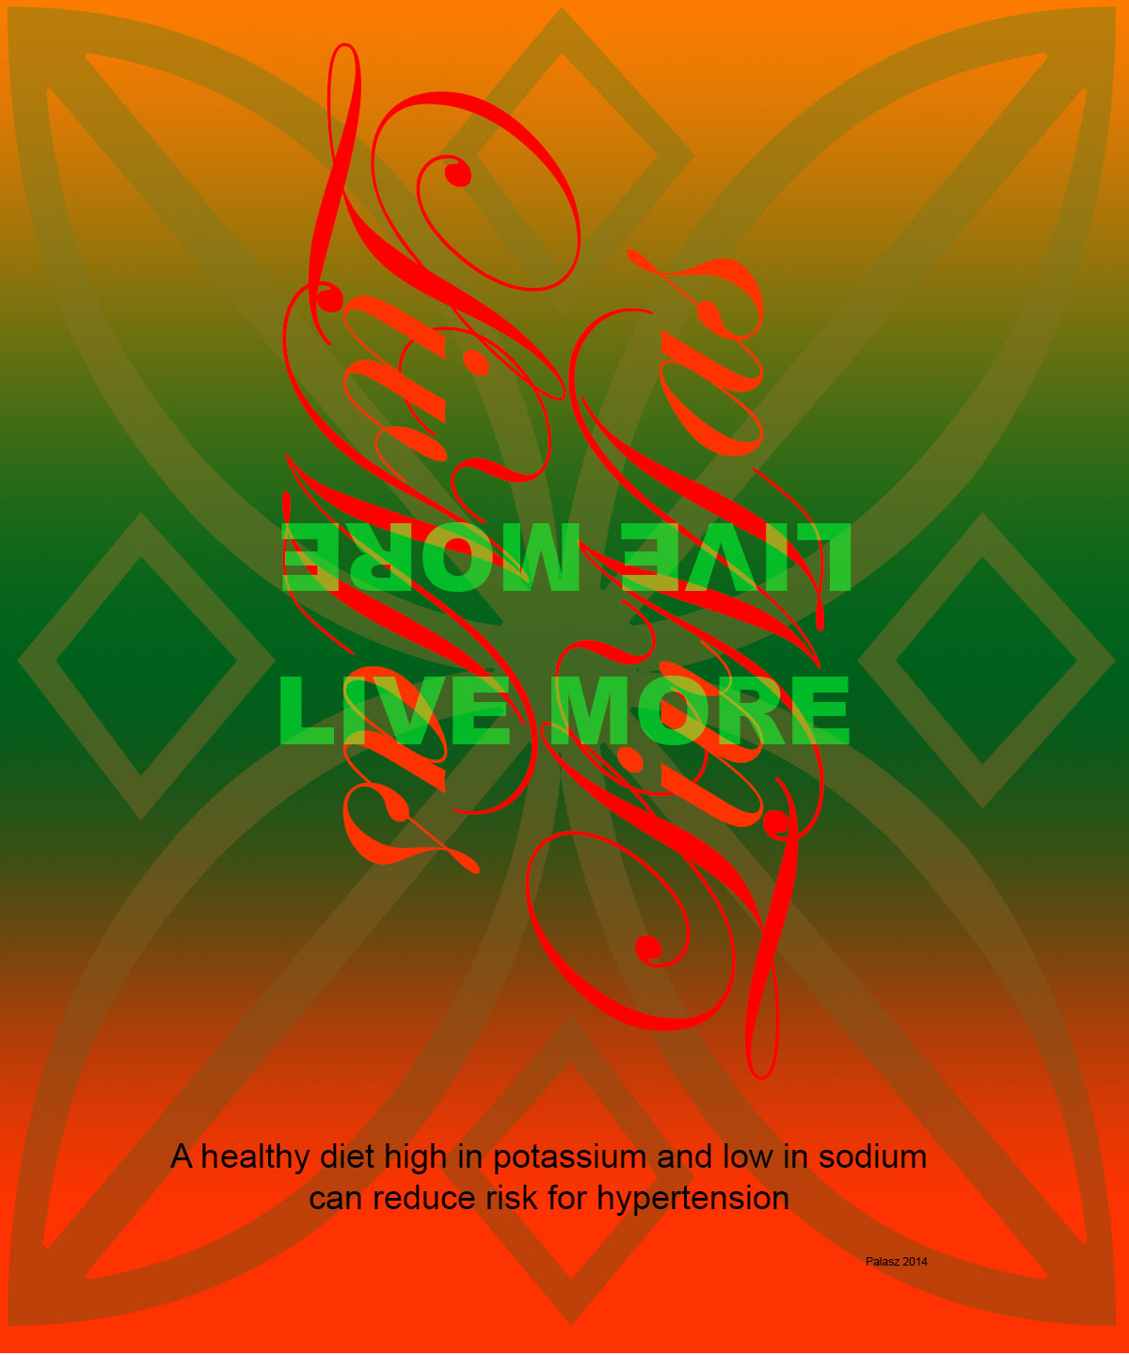
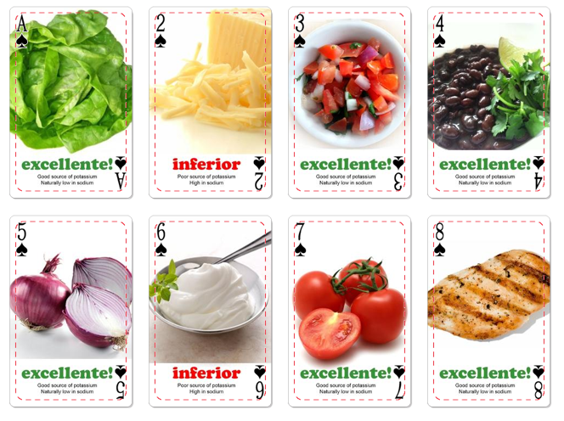
Live Mas!
An energetic card game for all ages that teaches
one to make healthier food choices when it comes to Mexican Food
Samantha Gogets Keri Palasz Nora Tramontina

Slide 2
Mexican Food = Healthy Food when you make good choices

Slide 3
Recipe Analysis Taco Bell Smothered Shredded Chicken Burrito
Calories: 650
Sodium: 2,220mg

Slide 4
Recipe Analysis Taco Bell XXL Grilled Stuffed Steak Burrito
Calories: 870
Sodium: 2,100mg

Slide 5
Mexican Food = Healthy Food when you make good choices
Simple Substitutions
can transform an unhealthy choice into a healthy choice

Slide 6
Recipe Makeover Chicken Burrito

Slide 7
Recipe Makeover Grilled Stuffed Steak Burrito

Slide 8
Let’s play a game! Live Mas = Live More

Slide 9
Excellente Cards = Good Choices Inferior Cards = Poor Choices Slap the inferior card, and yell LIVE MAS! Then, the first person to swap in an excellente card takes the pile. The person with the most cards at the end of the game, wins.

Slide 10
Mexican Food = Healthy Food Ready to play?

