Slide 1
Welcome to LITITZ ORTHODONTICS
We love to see you smile!
Notes:
This presentation demonstrates the new capabilities of PowerPoint and it is best viewed in Slide Show. These slides are designed to give you great ideas for the presentations you’ll create in PowerPoint 2011!
For more sample templates, click the File menu, and then click New From Template. Under Templates, click Presentations.

Slide 2
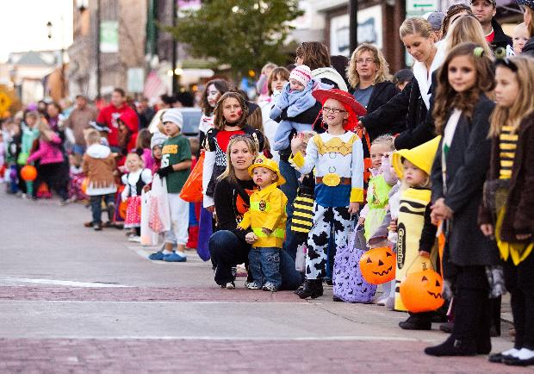
Lititz Halloween Parade
7pm
October 24, 2019

Slide 3
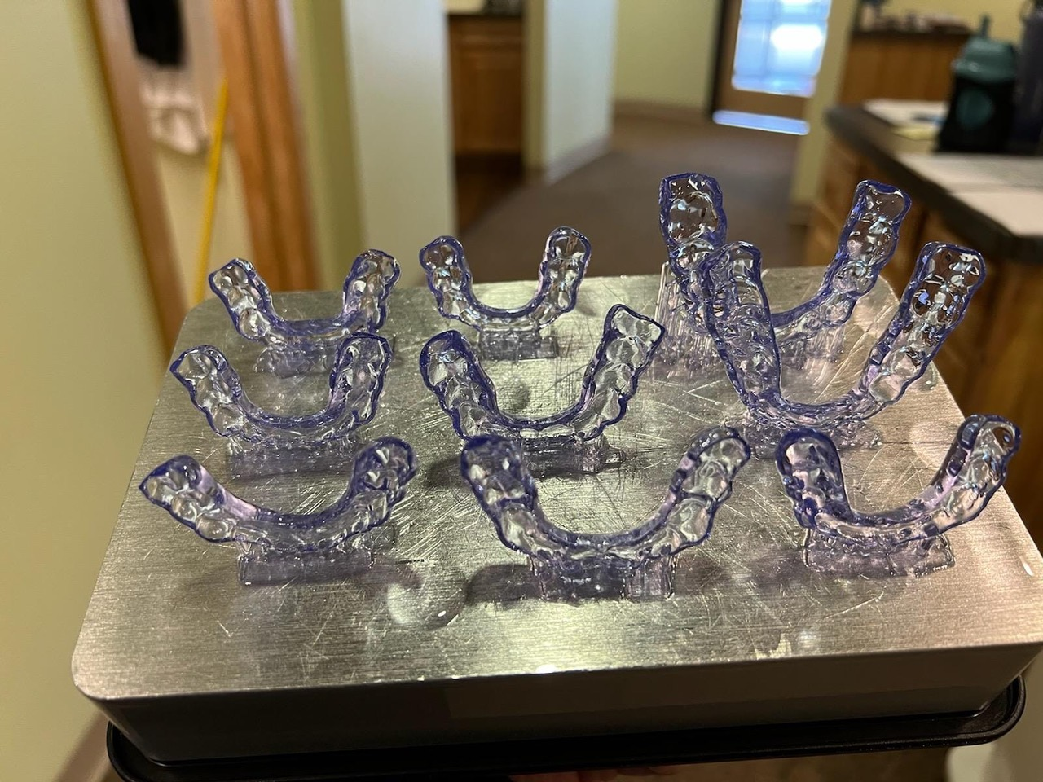
HYBRID TREATMENT
We use the power and precision of brackets and wires to move teeth quickly … and clear aligners to complete finishing work.
We make clear aligners right here in our office!
Your BEST SMILE … Faster.

Slide 4
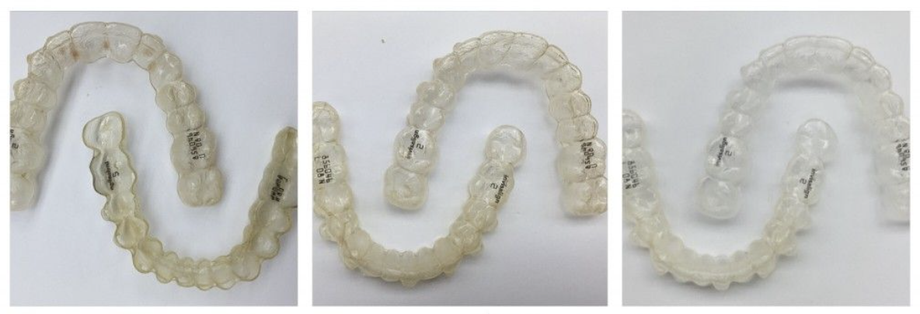
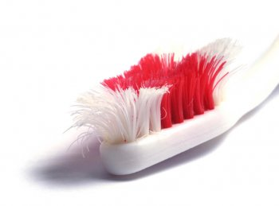
Time for something new?
Evaluate your toothbrush as well.
Retainers should be
replaced every 3 years
for best fit and for hygiene.
If anyone in your family needs a new retainer,
ask us today. We can digitally scan your teeth
(no more goopy impressions) and get retainers to you within days.

Slide 5
Ask us how
we can help
improve
your
Smile!

Slide 6
WE CARE ABOUT YOUR HEALTH
Wash your hands often with soap and water.
We are committed to providing a safe environment for all who work, visit, and receive care in our facilities.
Like our requirements for TB and MMR (measles, mumps & rubella), vaccination is a condition of employment.
Flu immunization protects our patients, employees, and community from getting this potentially serious infection.
Employees granted a medical or religious exemption will be required to wear a professionally fitted surgical mask when working within six feet of any person while the influenza virus is active in the community.

Slide 8
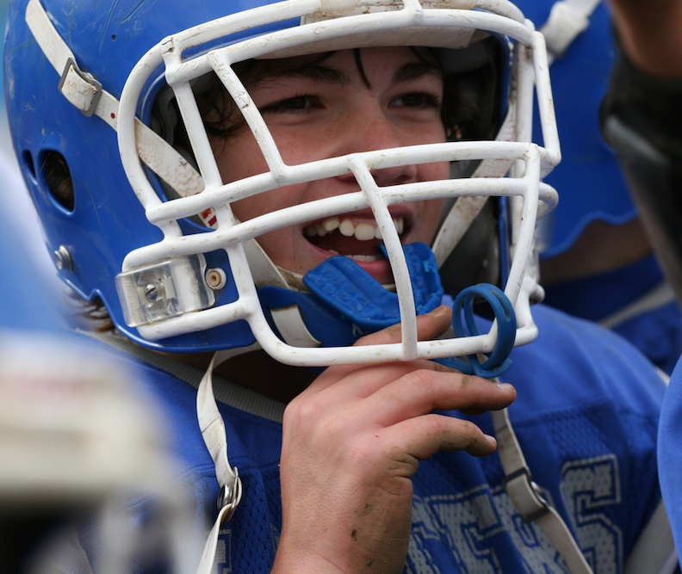
Wear your
Mouth Guard
while playing sports
Ask us about custom-fit mouth guards
for all family members who play sports.

Slide 9
From age 11-21 humans experience great cognitive and physical growth.
Age: Cognitive abilities
11-14: Focus is on the present
15-17: Understands the concept of consequences
18-21: Advanced cognitive ability
The ability to connect consequences to actions develops at age 15-17.
Nutrition, Health and Disease, A Lifespan Approach by Simon Langley- Evans
Keri Palasz, RDN, LDN

Slide 10
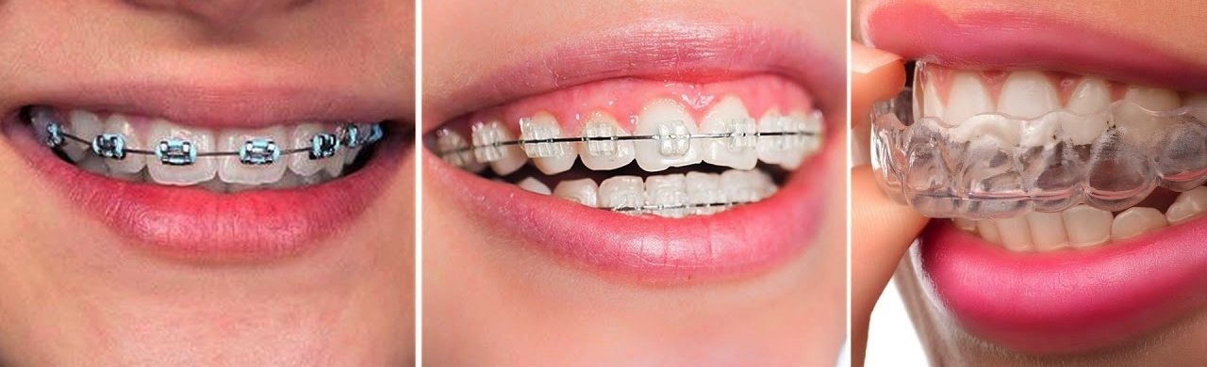
We do
HYBRID TREATMENT
Using the power and precision of brackets and wires to move teeth quickly … and clear aligners to complete finishing work.
Your BEST SMILE … Faster.

Slide 11
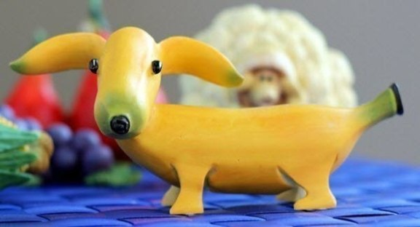
Which spelling is correct?
Curiousity or Curiosity?

Slide 12
Which spelling is correct?
Curiosity?

Slide 13
Remember the Mouth Rinse
* Freshens Breath Helps clean teeth *

Slide 14
PLAN TO KEEP YOUR TEETH FOR YOUR LIFETIME
Straight teeth are easier to keep clean.
Straight teeth chew better than crooked teeth.
We treat Moms, Dads, Grandmas, and Grandpas!

Slide 15
OCTOBER
Adopt A Shelter Dog Month

Slide 16
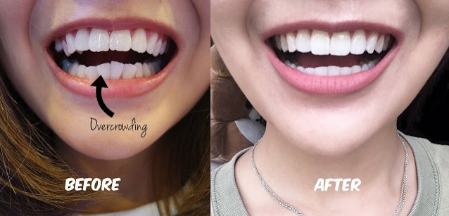
We can use Invisalign Clear Braces
to straighten teeth for Teens, Adults, and Seniors
You are NEVER too old to have a great smile!

Slide 17
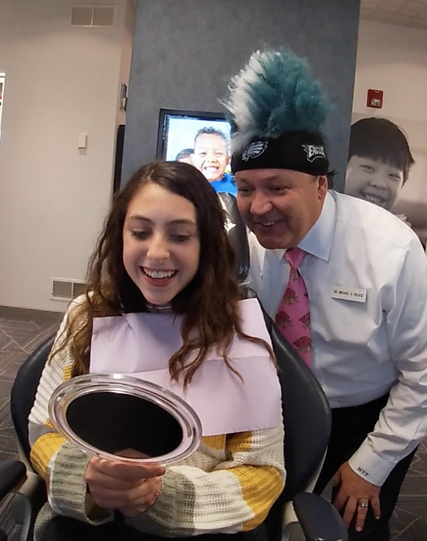
Like LITITZ ORTHODONTICS on FACEBOOK to see what fun we’re up to!

Slide 18
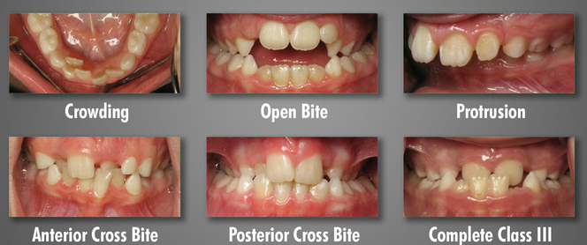
An orthodontic evaluation will help determine bite problems such as:
At Age 7

Slide 19
October 1
National
Homemade
Cookies
Day

Slide 20
Thinking about braces?
Ask us to schedule your free consult today!
We treat children, teens, adults, and seniors!

Slide 21
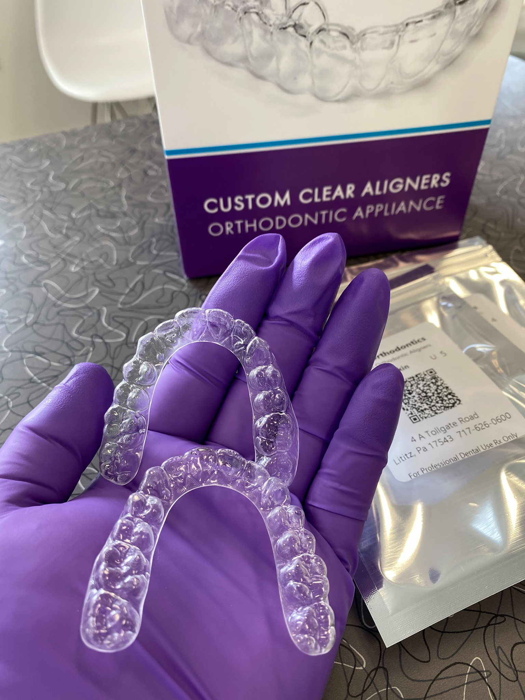
We make our own
Clear Aligners
to straighten teeth
for Teens, Adults,
and Seniors
You are NEVER too old to have a great smile!

Slide 22
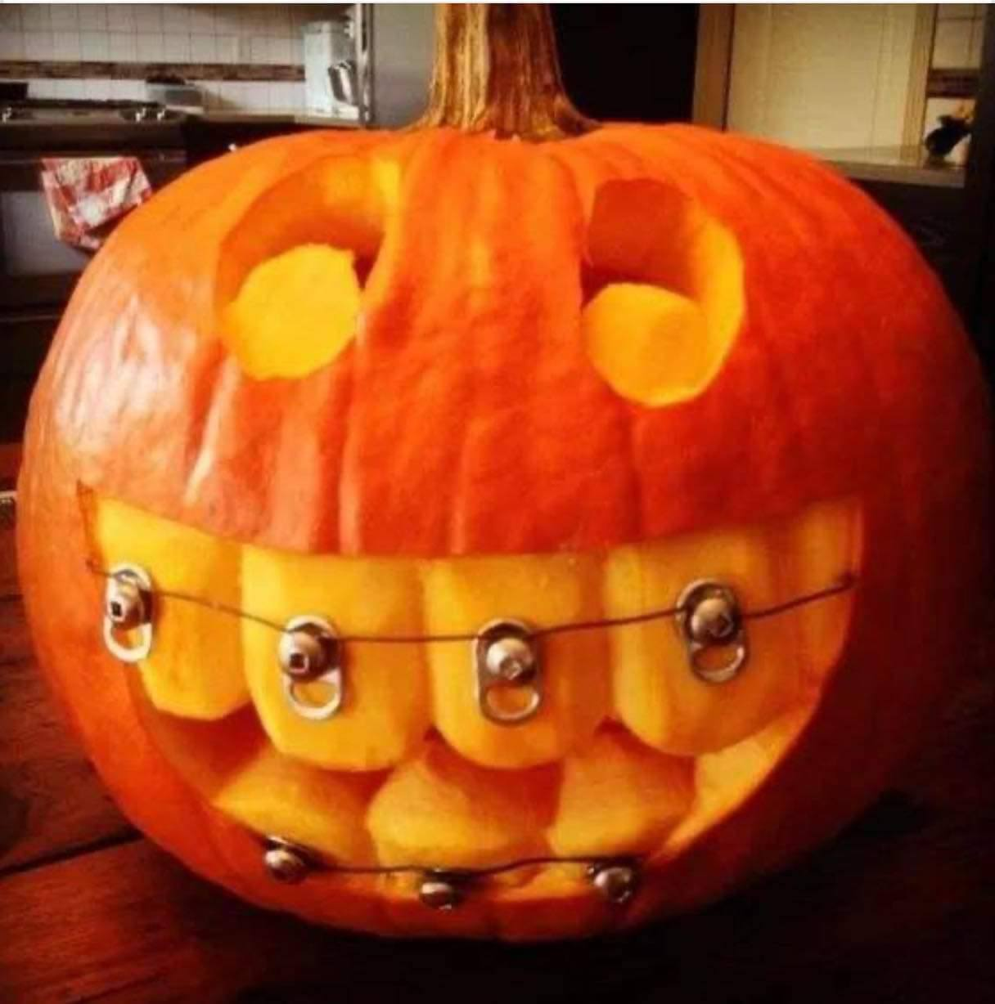
We love
to see
you
smile!

Slide 23
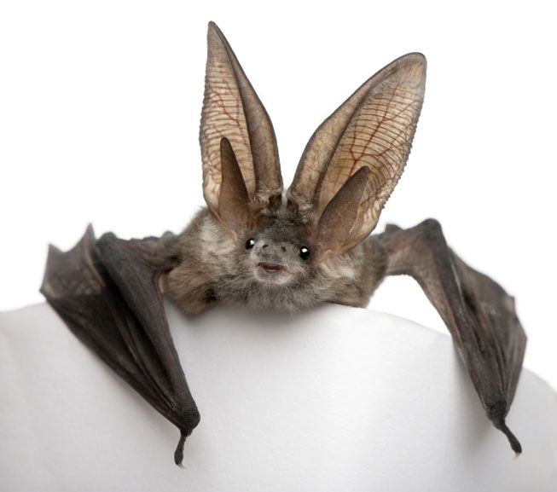
A Single Bat
can eat
more than
_____ bugs
an hour !

Slide 24
A Single Bat
can eat
more than
600 bugs
an hour !

Slide 25
Bad Breath
Bad breath is one of three reasons
people seek dental treatment.
If you have questions, we have answers.

Slide 26
The American
Association of Orthodontists recommends
that children
have an
orthodontic exam
by age 7.
BY AGE SEVEN
Notes:
This presentation demonstrates the new capabilities of PowerPoint and it is best viewed in Slide Show. These slides are designed to give you great ideas for the presentations you’ll create in PowerPoint 2011!
For more sample templates, click the File menu, and then click New From Template. Under Templates, click Presentations.

Slide 27
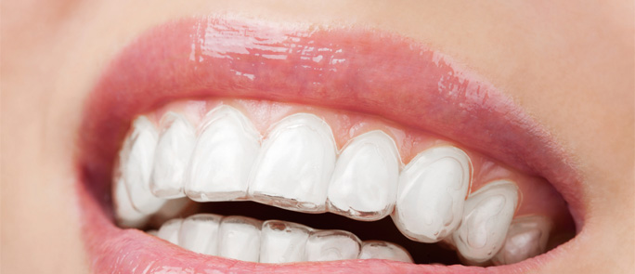
An Orthodontist
is the best doctor to confirm if you are a good candidate for clear aligners.
Ask Dr. Palasz if this form of treatment may be effective for you!

Slide 28
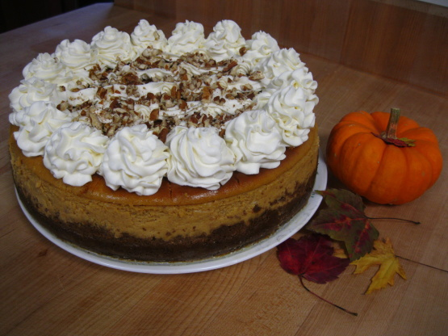
National Pumpkin Cheesecake Day
October 21

Slide 29
Many orthodontic patients
are adults!
You may be a candidate if you experience:
Headaches/Neck pain
Clenching/grinding/ Jaw joint pain
Crowded or rotated tooth positions
Self conscious about your smile
Ask us about
treatment options.
We can help!

Slide 30
FIRST EXAM BY AGE 7
At this complimentary exam we will:
* Determine if teeth are missing
* Evaluate that bones are growing properly
* Ensure permanent teeth are not damaged during eruption
* Reduce the need for extractions in the future
Notes:
This presentation demonstrates the new capabilities of PowerPoint and it is best viewed in Slide Show. These slides are designed to give you great ideas for the presentations you’ll create in PowerPoint 2011!
For more sample templates, click the File menu, and then click New From Template. Under Templates, click Presentations.

Slide 31
TRAILS
are safe places
to ride your bicycle.
traillink.com
Lists trails
around Lititz
for you to enjoy.

Slide 32
Visit our website!
717 626 0600
www.lititzortho.com

Slide 33
We can use Invisalign Clear Braces
to straighten teeth for Teens, Adults, and Seniors
You are NEVER too old to have a great smile!

Slide 34
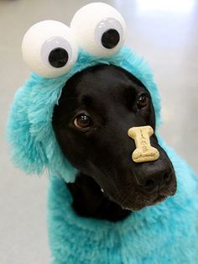
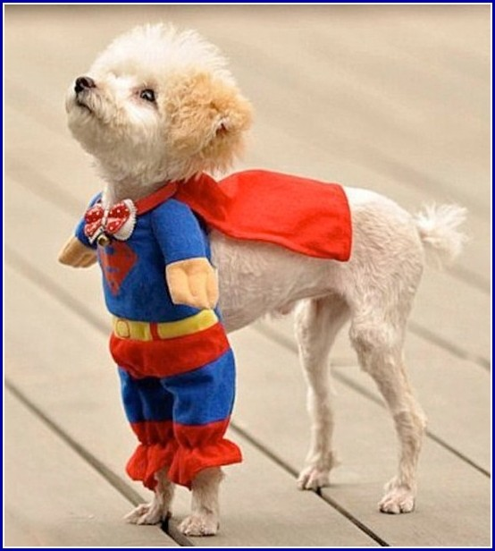
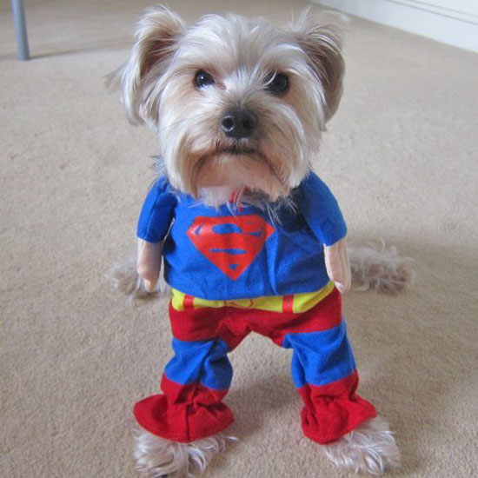
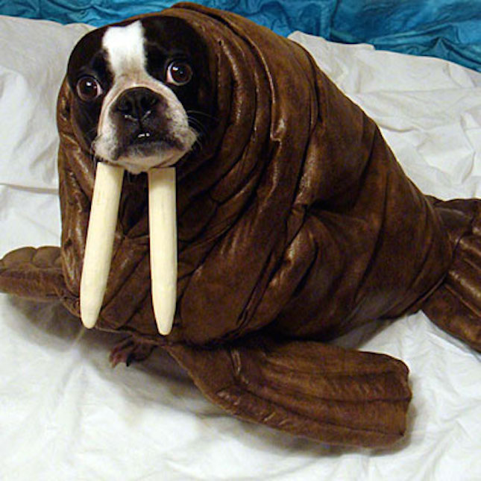
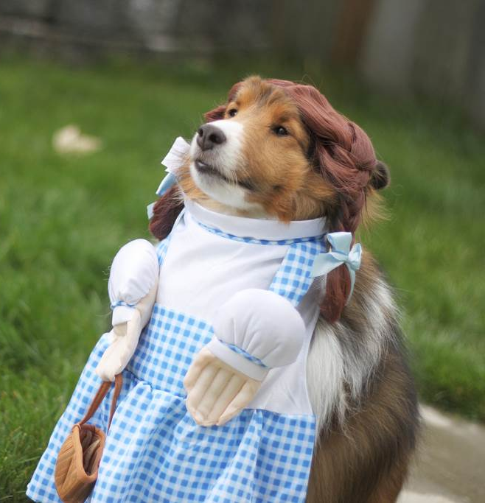
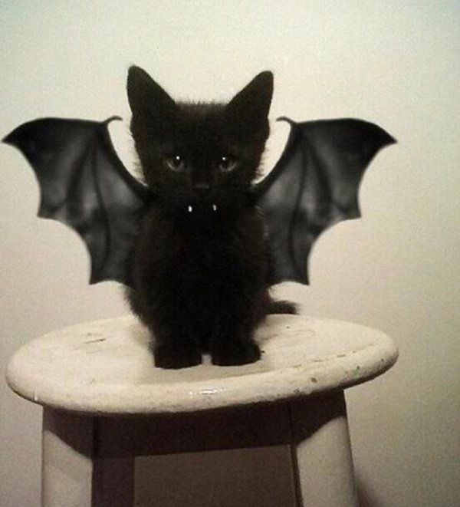
Which Pet Costume
is your favorite?

Slide 35
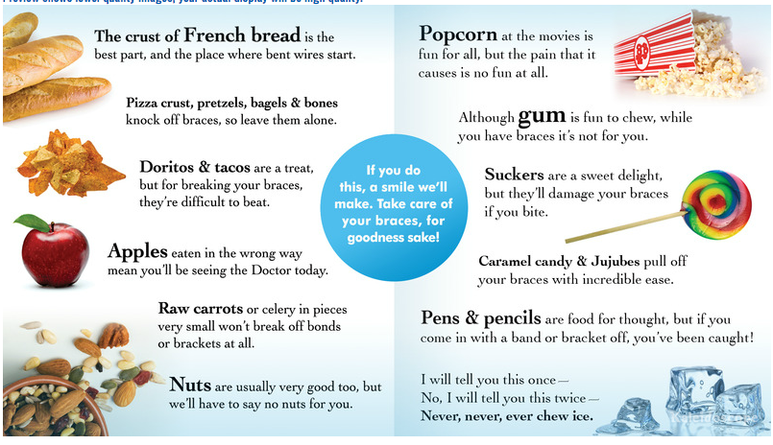
Poetic Advice to guide your
Food Choices While Wearing Braces

Slide 36
Your local resource for farm-fresh produce!
Join us in Lititz Springs Park
every Thursday from mid-May through October.
4:30pm - dusk

Slide 37
Ask us how
we can help
improve
your
Smile!

Slide 38
A smile is a curve that straightens everything out!

Slide 39
AUTUMN
one of the most colorful seasons!

Slide 40
An orthodontic evaluation will help determine bite problems such as:
At Age 7

Slide 41
Thumbsucking is a natural reflex for children.
Problems may arise
if it continues past age 3: * Improper mouth growth * Issues with teeth alignment * Changes in the roof of the mouth
If you are concerned
about your child’s thumbsucking, talk to us!

Slide 42
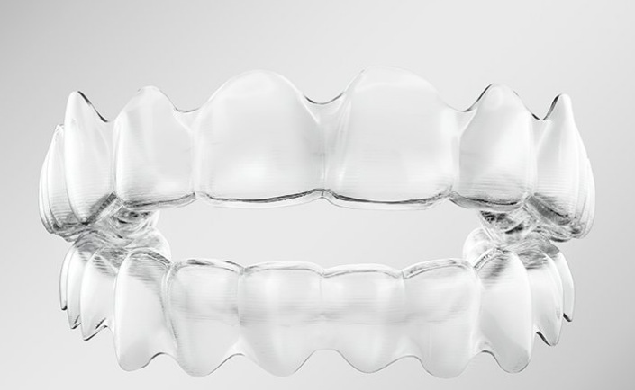
Smile more.
Ask us which clear braces options ~ including invisalign ~ are best for you!

Slide 45
Vitamin C
Are you getting enough every day?
Promotes healthy gums
Promotes skin elasticity
Improves Iron absorption
Promotes healthy immune system
Aids wound healing
So, how much do YOU need per day?
Have you ever caught a catfish?
Keri Palasz, RDN, LDN, https://ods.od.nih.gov/factsheets/VitaminC-HealthProfessional/

Slide 46
Vitamin C
One medium orange provides
all the vitamin C you need each day
… provides healthy natural fiber
…and TASTES GREAT!
Have you ever caught a catfish?
Keri Palasz, RDN, LDN, https://ods.od.nih.gov/factsheets/VitaminC-HealthProfessional/

Slide 48
We love
to see
you
smile!

Slide 49
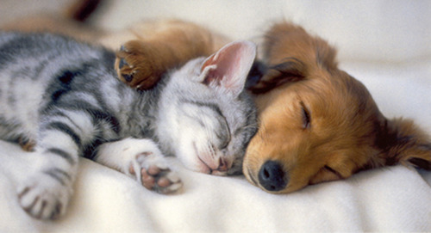
The CDC now recognizes that SLEEP
plays a critical role in good health.
People who are short on sleep have increased risk
for obesity, diabetes, hypertension.

Slide 50
We use
Digital Technology
To evaluate the condition
of your teeth and jaws,
while reducing
radiation exposure.

Slide 51
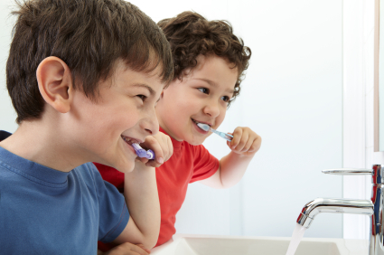
“I don’t wanna brush.”
Tell/Show/Do
Positive Reinforcement
Modeling

Slide 52
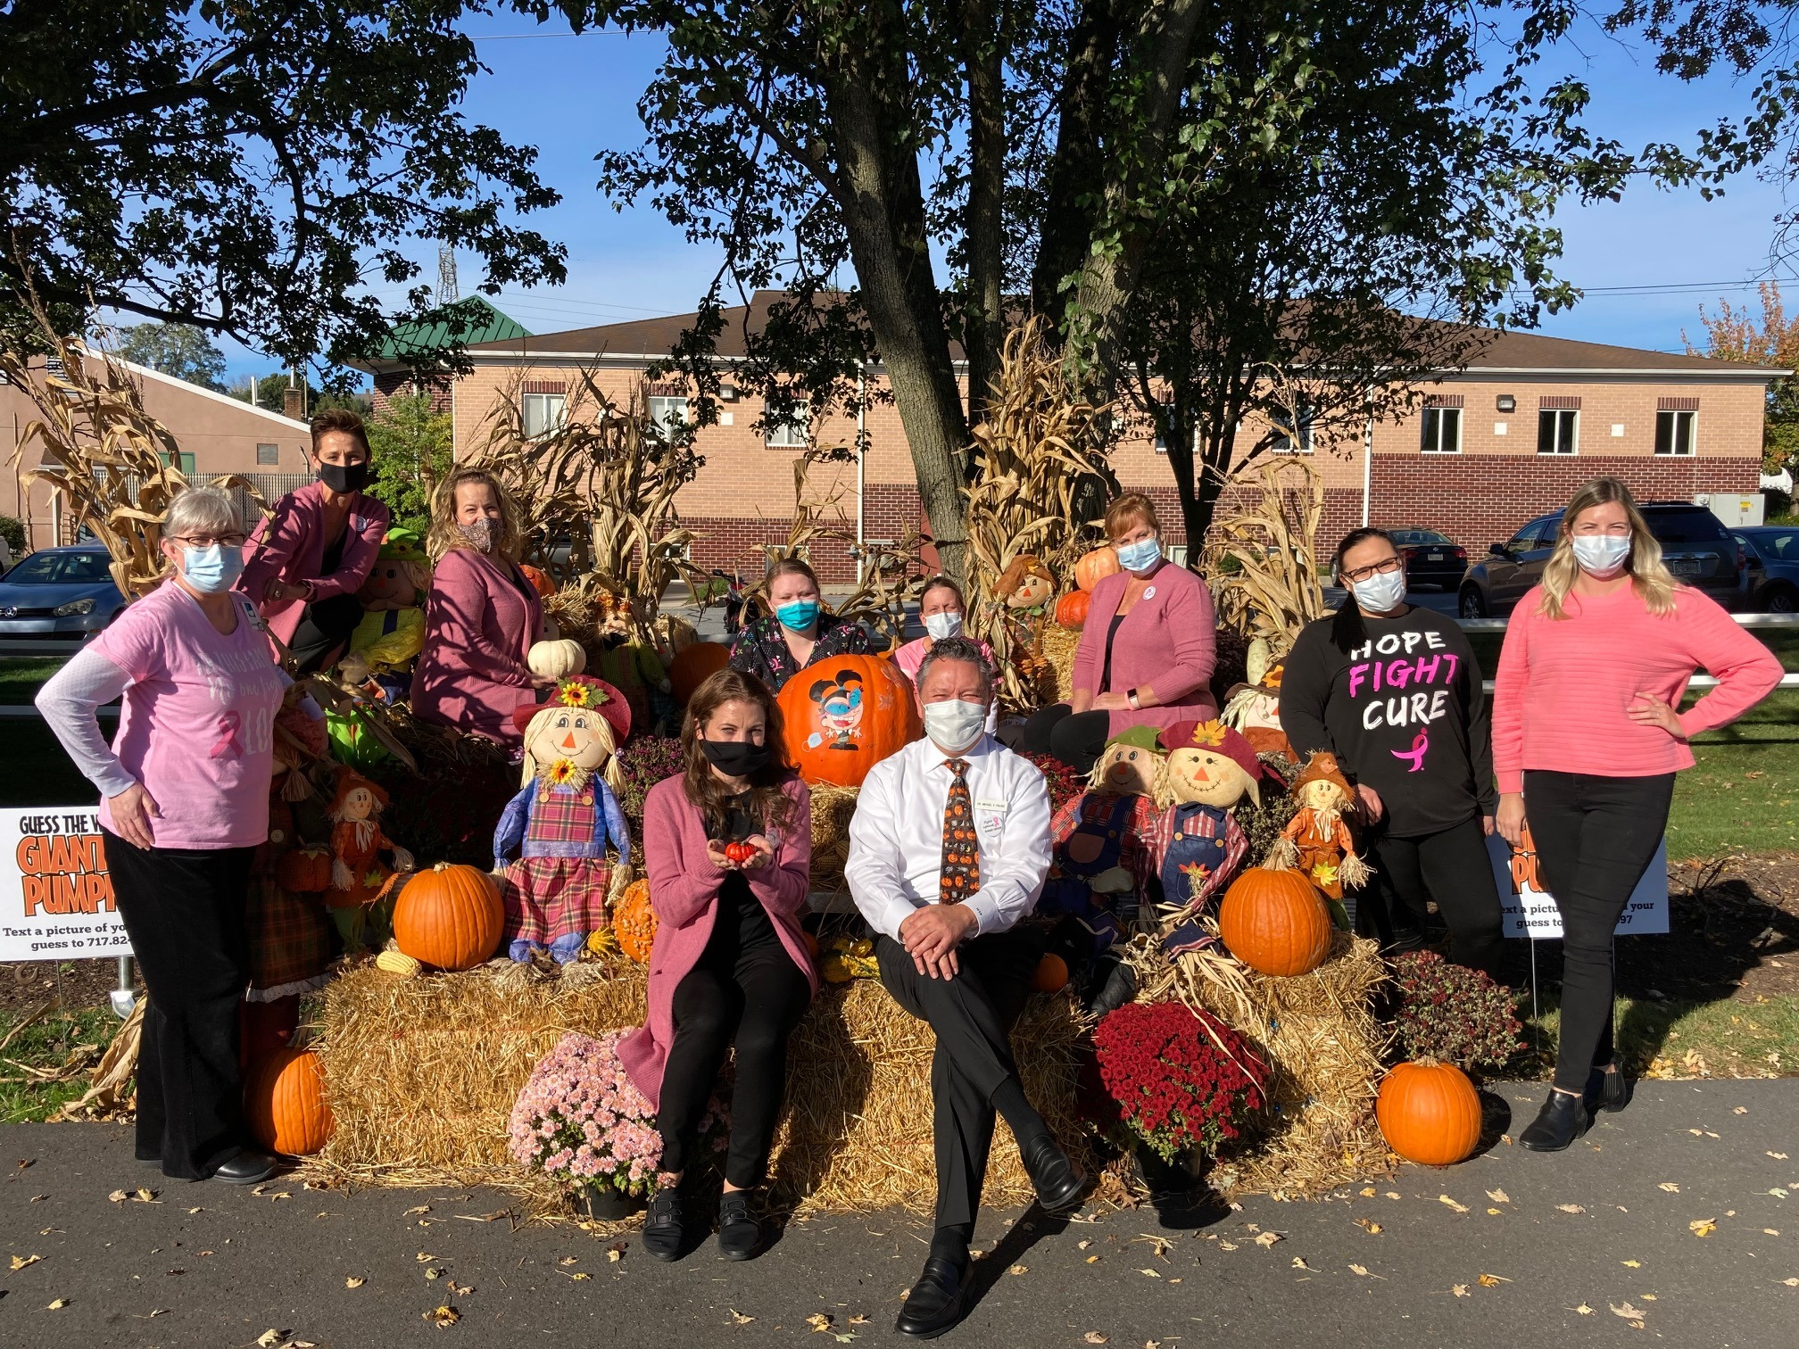
Like LITITZ ORTHODONTICS on FACEBOOK to see what fun we’re up to!

Slide 53
With early diagnosis
of Periodontal Disease, non-surgical treatments can help prevent tooth loss.
Ask us about your options today!

Slide 54
As teens grow, their muscle mass increases
& blood volume expands, increasing their need for IRON.
Iron-rich foods include:
lean meats
fish
poultry
iron-enriched or fortified
cereals, breads, pasta, rice
dried fruits
leafy green vegetables
dried beans, peas and lentils
~Keri Palasz, RDN, LDN
www.eatright.org

Slide 55
Floss Daily!
Over 3 million miles of dental floss are purchased in North America each year. Make sure you are part of that movement.

Slide 56
#1
Ayudar a su hijo a tener éxito en la escuela
Help your child succeed in school
Asistir a conferencias de padres y maestros
Attend Parent-Teacher conferences

Slide 57
#2
Ayudar a su hijo a tener éxito en la escuela
Help your child succeed in school
Visite la escuela y su sitio web
Visit the school and its website

Slide 58
#3
Ayudar a su hijo a tener éxito en la escuela
Help your child succeed in school
Expectativas de la tarea de la ayuda
Support homework expectations

Slide 59
#4
Ayudar a su hijo a tener éxito en la escuela
Help your child succeed in school
Envíe a su niño a la escuela listo para aprender, habiendo consumido un desayuno nutritivo
Send your child to school ready to learn, having consumed a nutritious breakfast.

Slide 60
Orthodontic Treatment can resolve cosmetic, functional, and physiological issues such as:
Teeth crowding
Spaced, missing, or extra teeth
Retruded or protruded teeth or jaws
An open bite
Difficulty chewing, swallowing
Speech problems
Headaches, facial, or neck pain
Jaw popping or clicking
Ask us about treatment options. We can help!

Slide 61
We love
to see
you
smile!

Slide 62
The average adult between the ages
of 20-64 has three or more decayed or missing teeth.
If you are missing any teeth,
ask us how we can help you rejuvenate your smile!

Slide 63
For kids, exercise means playing
and being physically active.

Slide 64
A healthy bite, healthy gums, and a
healthy smile mean a healthy YOU!

Slide 65
Ask us how
we can help
improve
your
Smile!

Slide 66
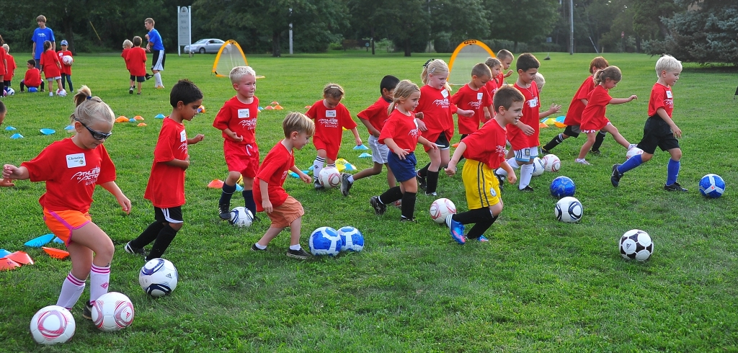
Wear your Mouth Guard while playing sports
Ask us about custom-fit mouth guards
for all family members who play sports.

Slide 67
We love to see you smile!

Slide 68
Like us on
FaceBook

Slide 69
We can use Invisalign Clear Braces
to straighten teeth for Teens, Adults, and Seniors
You are NEVER too old to have a great smile!

Slide 71
WHAT TO DO
In case of an
after-hours emergency:
Call our office and follow the instructions outlined in our recorded message.
717 626 0600

Slide 72
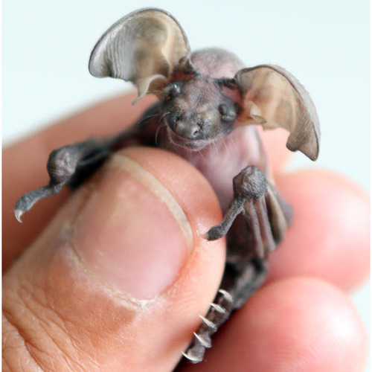
What
do you call
a baby bat?

Slide 73
What
do you call
a baby bat?
A Pup

Slide 74
!
We love to see you smile!
Notes:
This presentation demonstrates the new capabilities of PowerPoint and it is best viewed in Slide Show. These slides are designed to give you great ideas for the presentations you’ll create in PowerPoint 2011!
For more sample templates, click the File menu, and then click New From Template. Under Templates, click Presentations.

Slide 75
PLAN TO KEEP YOUR TEETH FOR YOUR LIFETIME
Straight teeth are easier to keep clean.
Straight teeth chew better than crooked teeth.
We treat Moms, Dads, Grandmas, and Grandpas!

Slide 76
For kids, exercise means playing
and being physically active.

Slide 77
WHAT TO DO
In case of an
after-hours emergency:
Call our office and follow the instructions outlined in our recorded message.
717 626 0600

Slide 78
Bad breath
is one of three reasons people seek dental treatment.
If you have questions, we have answers.

Slide 79
Kids need MORE calcium from age 9-18 than at any other point in their lives. Why? To support growth during adolescence.
Calcium intake for ages 9-18: 1,300mg per day.
National Institutes of Health
Keri Palasz, RDN, LDN

Slide 80
Visit our website!
www.lititzortho.com
717 626 0600

Slide 81
Thank you!
A referral is the highest compliment you can give us.

Slide 82
Time for something new?
Evaluate your toothbrush as well.
Retainers should be
replaced every 3 years
for best fit and for hygiene.
If anyone in your family needs a new retainer,
ask us today. We can digitally scan your teeth
(no more goopy impressions) and get retainers to you within days.

Slide 83
We make our own
Clear Aligners
to straighten teeth
for Teens, Adults,
and Seniors
You are NEVER too old to have a great smile!

Slide 84
Ask how we can help you
have the healthiest teeth & gums!
Notes:
This presentation demonstrates the new capabilities of PowerPoint and it is best viewed in Slide Show. These slides are designed to give you great ideas for the presentations you’ll create in PowerPoint 2011!
For more sample templates, click the File menu, and then click New From Template. Under Templates, click Presentations.

Slide 85
Wear your Mouth Guard while playing sports
Ask us about custom-fit mouth guards
for all family members who play sports.

Slide 86
An orthodontic evaluation will help determine bite problems such as:
At Age 7

Slide 87
!
We love to see you smile!
Notes:
This presentation demonstrates the new capabilities of PowerPoint and it is best viewed in Slide Show. These slides are designed to give you great ideas for the presentations you’ll create in PowerPoint 2011!
For more sample templates, click the File menu, and then click New From Template. Under Templates, click Presentations.

Slide 88
Which Pet Costume
is your favorite?

Slide 89
Tooth Whitening
Is one of the simplest and least expensive ways
to enhance your smile and restore
a youthful appearance.
Ask us how
we can help rejuvenate
YOUR smile!
Notes:
This presentation demonstrates the new capabilities of PowerPoint and it is best viewed in Slide Show. These slides are designed to give you great ideas for the presentations you’ll create in PowerPoint 2011!
For more sample templates, click the File menu, and then click New From Template. Under Templates, click Presentations.

Slide 90
The American Association of Orthodontists recommends
that children have an orthodontic exam by age 7.
Notes:
This presentation demonstrates the new capabilities of PowerPoint and it is best viewed in Slide Show. These slides are designed to give you great ideas for the presentations you’ll create in PowerPoint 2011!
For more sample templates, click the File menu, and then click New From Template. Under Templates, click Presentations.

Slide 91
Ask us how
we can help
improve
your
Smile!

Slide 92
Smile more.
Ask us which clear braces options ~ including invisalign ~ are best for you!

Slide 93
FIRST EXAM BY AGE 7
At this complimentary exam we will:
* Determine if teeth are missing
* Evaluate that bones are growing properly
* Ensure permanent teeth are not being damaged during eruption
* Reduce the need for extractions in the future
Notes:
This presentation demonstrates the new capabilities of PowerPoint and it is best viewed in Slide Show. These slides are designed to give you great ideas for the presentations you’ll create in PowerPoint 2011!
For more sample templates, click the File menu, and then click New From Template. Under Templates, click Presentations.

Slide 94
Thinking about braces?
Ask us to schedule your free consult today!

Slide 95
Why improve your smile … Ask us about YOUR options!
HEALTH REASONS:
Worn, chipped or cracked teeth
Gum recession
Jaw pain, headaches
COSMETIC REASONS:
Unaesthetic spacing of teeth
Short or long teeth
Gummy smile
Aged or worn smile

Slide 96
Wear your Mouth Guard while playing sports
Ask us about custom-fit mouth guards
for all family members who play sports.

Slide 97
Brush & Floss Daily
It’s never too early to brush and floss!
40-50% of kids experience tooth decay before age 5.

Slide 98
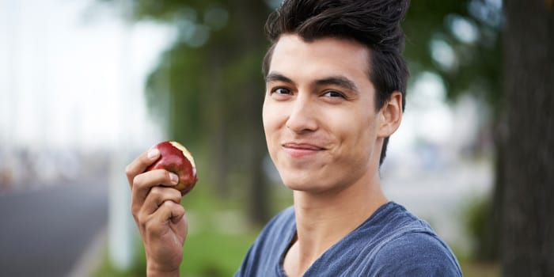
Fruit that ripens
in October in PA:
_________

Slide 99
Fruit that ripens
in October in PA:
APPLE

Slide 101
We make our own
Clear Aligners
to straighten teeth
for Teens, Adults,
and Seniors
You are NEVER too old to have a great smile!

Slide 102
Visit our website!
www.lititzortho.com
717 626 0600

Slide 103
Orthodontic Treatment can resolve cosmetic, functional, and physiological issues such as:
Teeth crowding
Spaced, missing, or extra teeth
Retruded or protruded teeth or jaws
An open bite
Difficulty chewing, swallowing
Speech problems
Headaches, facial, or neck pain
Jaw popping or clicking
Ask us about treatment options. We can help!

